Slide 1







9h30-10h
Welcome Words
Académie du Climat
20 June 2023
Affordable Housing Initiative
Finance Summit
www.shape-affordablehousing.eu
Paris, France

Slide 2

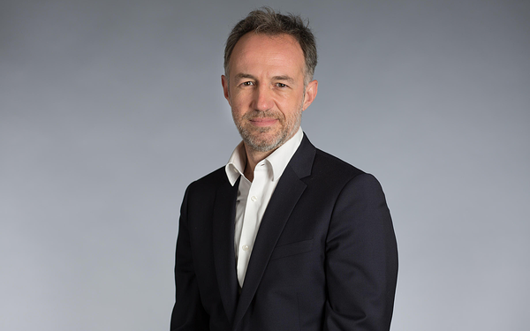
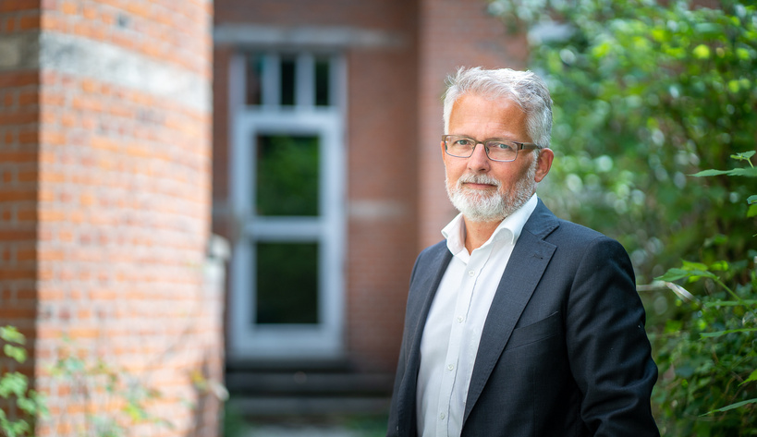

Emmanuel Grégoire
First Deputy Mayor of Paris in charge of urban planning
Bent Madsen
President of Housing Europe
Welcome Speeches

Slide 3
10h-11h
Official opening -
High level round table
Académie du Climat
20 June 2023
Affordable Housing Initiative
Finance Summit
www.shape-affordablehousing.eu
Paris, France

Slide 4

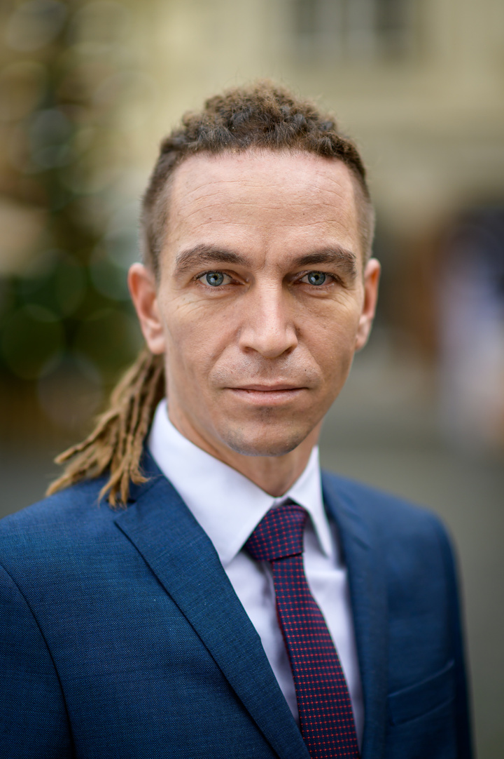
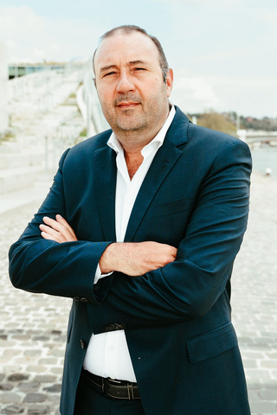


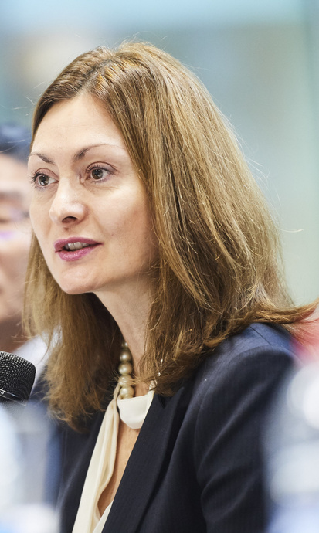

Official opening - High level round table
Olivier Klein
Minister Delegate for Cities and Housing, France
Ivan Bartoš
Minister of Regional Development,
Czechia
Christophe Collignon
Minister of Housing,
Local Powers and the City,
Wallonia, Belgium
Hugo de Jonge
Minister of Housing,
the Netherlands
Marina Gonçalves
Minister of Housing,
Portugal
Ana Athanasopoulou
Head of Unit, Proximity, Social Economy and Creative Industries’, European Commission Directorate General of Internal Market, Industry, Entrepreneurship and SMEs
Emmanuelle Cosse
President of l’Union Sociale
pour l’Habitat

Slide 5
11h-11h30
Interview on the role of development banks
Académie du Climat
20 June 2023
Affordable Housing Initiative
Finance Summit
Paris, France
www.shape-affordablehousing.eu

Slide 6

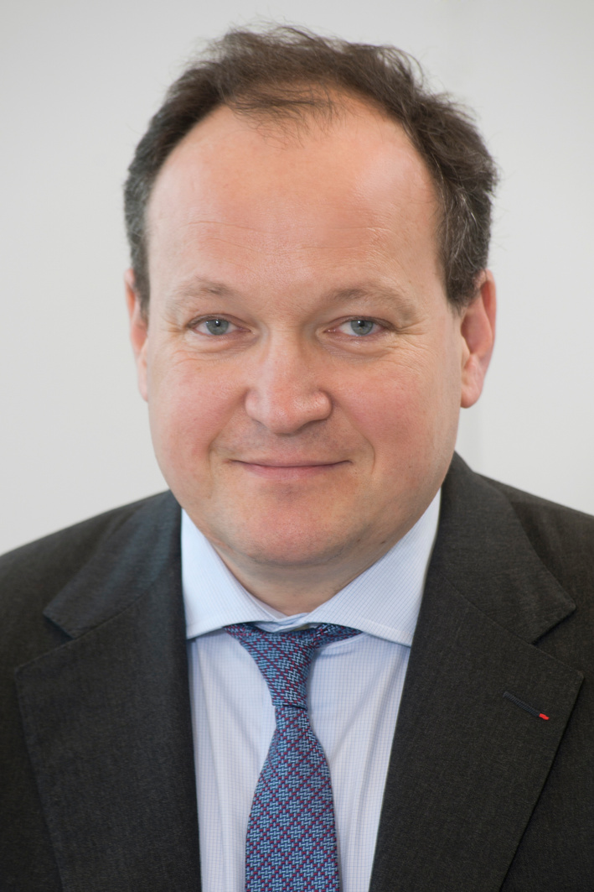
Sandrine Gaudin
Vice-Governor of CEB
Ambroise Fayolle
Vice-President of EIB
Interview on the role of development banks

Slide 7
11h45-12h15
Findings of the
State of Housing 2023
Académie du Climat
20 June 2023
Affordable Housing Initiative
Finance Summit
www.shape-affordablehousing.eu
Paris, France

Slide 8

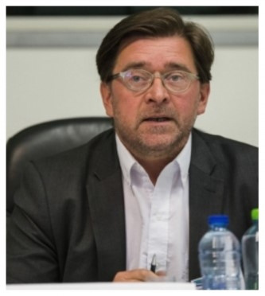
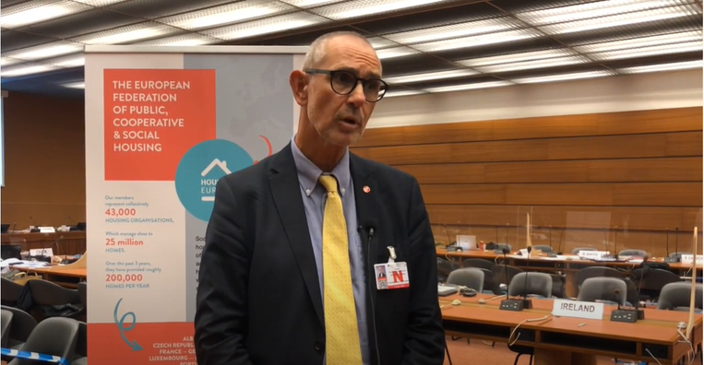
Alice Pittini
Research Director
Housing Europe
Laurent Ghékière
Chair of
Housing Europe Observatory
Head of EU Affairs,
l’Union Social pour l’Habitat, France
Christian Krainer
Vice-Chair of
Housing Europe Observatory
Representative of GbV, Austria
Findings of the
State of Housing 2023

Slide 9
12h15-13h15
WHAT ROLE CAN FINANCE AND EU FUNDING PLAY TO ADVANCE INTEGRATED
DISTRICT RENEWAL &
THE FAIR ENERGY TRANSITION
IN HOUSING?
Académie du Climat
20 June 2023
Affordable Housing Initiative
Finance Summit
www.shape-affordablehousing.eu
Paris, France

Slide 10
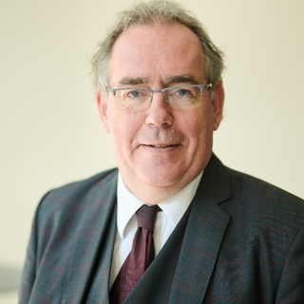
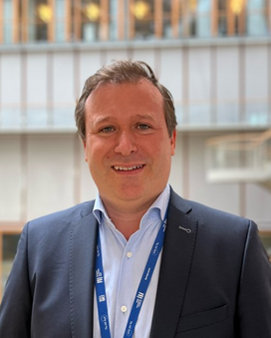


Jonathan Denness
-Head of Unit, Financial instruments Unit, DG Regio
Eduard Perard
Head of Urban Development Division, EIB
Carlos Sanchez Rivero
Team Leader Financing for Energy Efficiency, DG ENER, European Commission
Laurent Zylberberg
President of European Long-Term Investors Association (ELTI)
1st panel - The perspective of the housing providers and cities:

Slide 11
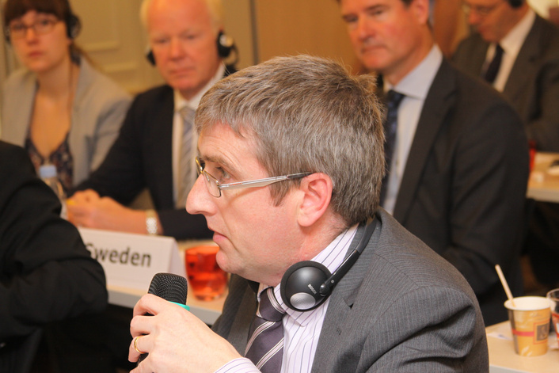


Donal McManus
CEO of Irish Council for Social Housing
María Montes Miguel
Director General, AVS
Spain
André Sobczak
Secretary General of EUROCITES
2nd panel - The perspective of the housing providers and cities:

Slide 12
14h15-15h00
WHERE FINANCE AND GOOD GOVERNANCE MEET: WHAT WORKS TO ATTRACT FUNDING?
Académie du Climat
20 June 2023
Affordable Housing Initiative
Finance Summit
www.shape-affordablehousing.eu
Paris, France

Slide 13
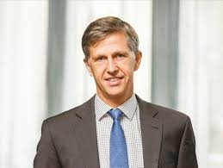
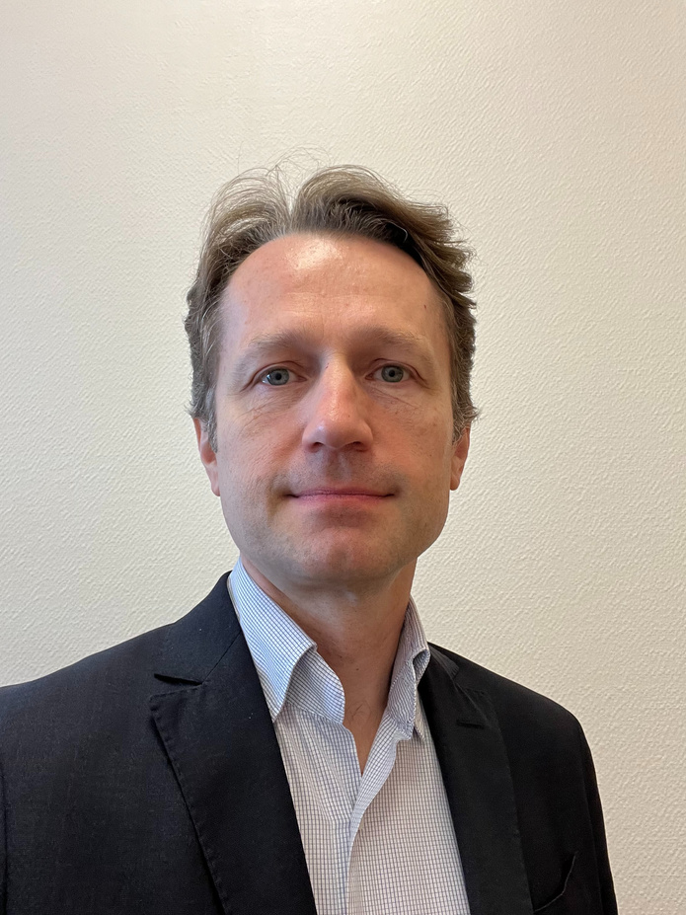
Tanguy Desrousseaux
Head of Division, Public Sector and Infrastructure,
Western Europe Department, EIB
Christophe Mróz
Principal Country Manager, CEB
The European Alliance for Social Housing in France

Slide 14



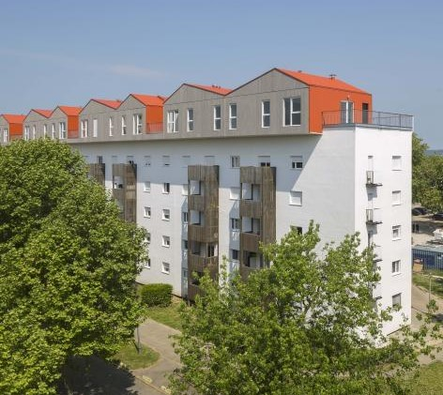


France
European Alliance for Sustainable and Inclusive Social Housing
- France -
European Union
Requirement for LT financing
Framework loans
EIB – CDC bilateral agreements
New social housing
Wave of renovations of social housing (Climate bank)
+ InvestEU garantee
Long-term investment priorities
Requirement for LT financing for 630 HLM bodies
Linkage between Loans and others EU Subsidies (ERDF + InvestEU garantee) : 436 millions ERDF
Communication / financed projects
+
Intermediated LT loans
Council of Europe
A partnership to bring Europe closer to its citizens and its local communities
Framework loans
Investments that are clear to the beneficiary households, and that are promoted on social media
#SocialHousingAlliance
EIB + CEB loans combined with FR regulated loans
Livret A - CDC-EIB and CDC-CEB bilateral agreements
A “one-stop-shop”
for 630 HLM Housing Associations
+ 1,950 billions Euros LT Loans Fixed Rates (2021)
+ InvestEU Garantee
CEB – CDC bilateral agreements
Sheltered housing – Housing for homeless people
Energy poverty
Housing for immigrants and refugees
+ InvestEU Garantee
Lisibilité acteurs locaux et ménages locataires
Communication adaptée - Réseaux sociaux

Slide 15

Andres Jaadla
EKYL, CEO
The Estonian housing governance system

Slide 16
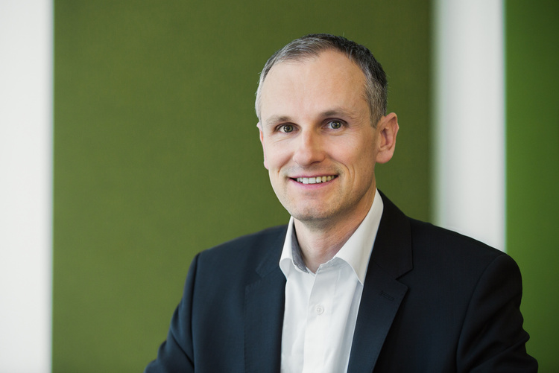

Peter Surek
Head of Social finance
Sorcha Edwards
Secretary General of Housing Europe
The European Housing Finance Working Group

Slide 17
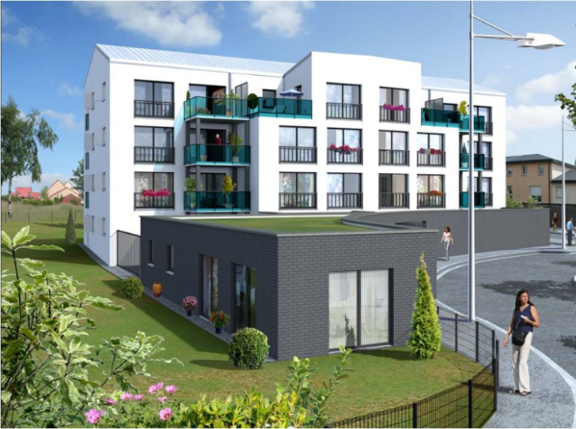
Objective: next generation neighbourhoods
Covid-19 pandemic → need to ensure that our neighbourhoods are opportunity and productivity hubs/safe and healthy places.
Accessibility both physically & financially for different age groups, different career profiles, different walks of life.
Need to improve homes to fulfil new functions without pricing people out:
Including work & study spaces to enable a productive life
Improving homes reduce inequalities (inadequate housing reinforce this we are obliged to ‘stay at home’)
Through saving, storage/generation, our homes and neighbourhoods need to become an integral part of a clean energy infrastructure.
Our next generation Neighbourhoods should be a space where people can thrive (local resilience, inclusion and job creation)
The European Housing Finance Working Group

Slide 18
2 Strands:
Exchange on inspiring/replicable initiatives
help Member States to deliver the Principle 19 of the EU Social Pillar Action Plan
build on the Nice Declaration, in which the 27 Ministers ask the EIB to continue and develop further its financing and advisory services
Capacity building to mobilize finance in the sector
Thematic meetings
Peer-to-peer exchange
An annual EU Social & Affordable Housing Summit
The European Housing Finance Working Group

Slide 19
15h00-15h45
INVENTING THE WHEEL: FINANCING MECHANISMS THAT SUIT INTEGRATED APPROACHES TO RENOVATION
Académie du Climat
20 June 2023
Affordable Housing Initiative
Finance Summit
www.shape-affordablehousing.eu
Paris, France

Slide 20
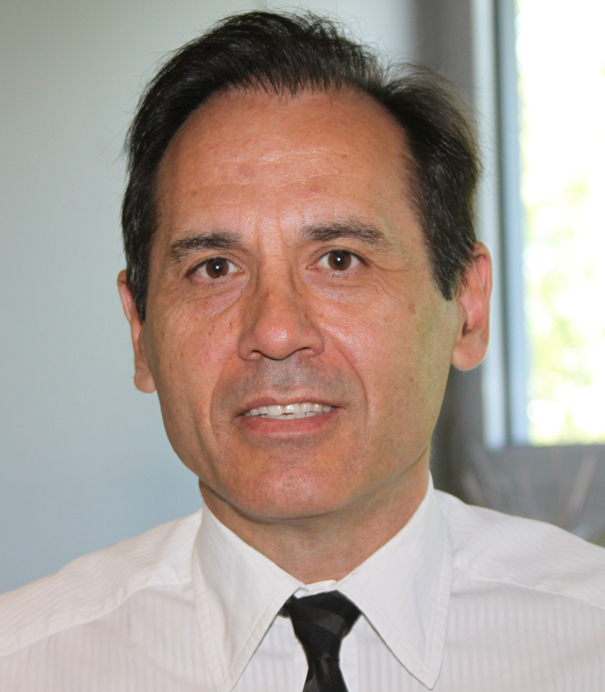
Juan Alario
Senior Consultant at GNE Finance, Former EIB Associate Director
Funding mapping: guiding developers to potential sources of financing

Slide 21
Key challenges
  District-level renovations of houses owned by homeowners is more challenging than when they are owned by a single entity, like a social housing provider.
  Financing costly renovation, such as deep energy renovations, can be difficult
  Financing the housing association rather than the homeowners in multi-family buildings can be difficult, as few financial institutions are willing to finance these associations
  On the plus side, large district-level renovation projects have the possibility to develop financing at scale, which can significantly reduce the cost of financing and develop adapted financial products

Slide 22
Public initiatives to facilitate financing of building renovations
Objectives
  Minimize guarantee and self-financing requirements
  Reduce the cost of financing (fees and interest rates)
  Longer loan maturities to reduce monthly payments
  Mobilize private finance
Ways to facilitate financing:
  Increase access to grants, soft loans or public guarantees
  Promote that financing institutions develop green lending products
  Develop innovative financing, such as green mortgages, on-tax or on-bill financing

Slide 23
Steps to prepare the financing strategy for a district renovation
Prepare an information memorandum for Financial Institutions (FIs):
  Feasibility studies
  Borrower(s) characteristics
  Financial plan (some energy investments could be finance in a separate way)
  Financial strategy
Select best offers from FIs

Slide 24
Main ways to finance renovations
    Own resources,
    Grants,
    Public finance,
    Commercial loans.
    Contributions from tenants for rented buildings.

Slide 25
Financial products
  the main ways to access public finance for small renovation investments is through dedicated credit lines and specialized funds. In addition, certain public guarantee instruments exist
  Many commercial banks are developing specific home renovation products
  Green bonds (large projects)
  Green mortgages, on-tax or on-bill financing (but limited development at this stage)
  Specialized financing products for some energy production investments (e.g. leasing or energy supply contracts) or for district heating/cooling networks
  Some of these products are only applicable to large projects (see graph)

Slide 26
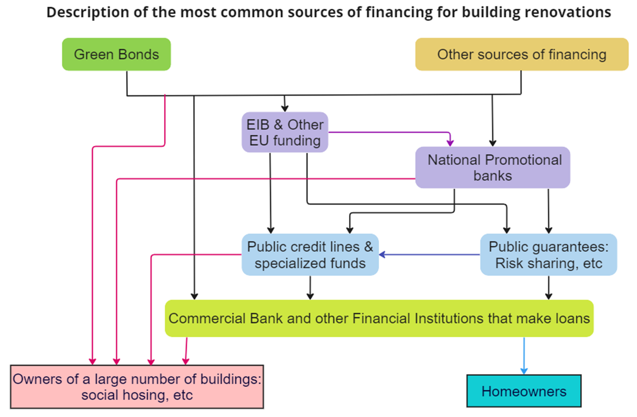
The most common sources of debt financing for building renovations

Slide 27
Shape EU. Access to funding handbook
  It lays out the key challenges and the main financial products to finance building renovations
  It analyses the main sources of financing for housing renovations:
    EU financing
    Financing in EU member states (only for some countries)
    Private financing
  For each type, it lays out:
    Type of projects that can be financed
    Financial products available
    How to access financing, benefits and limitations

Slide 28

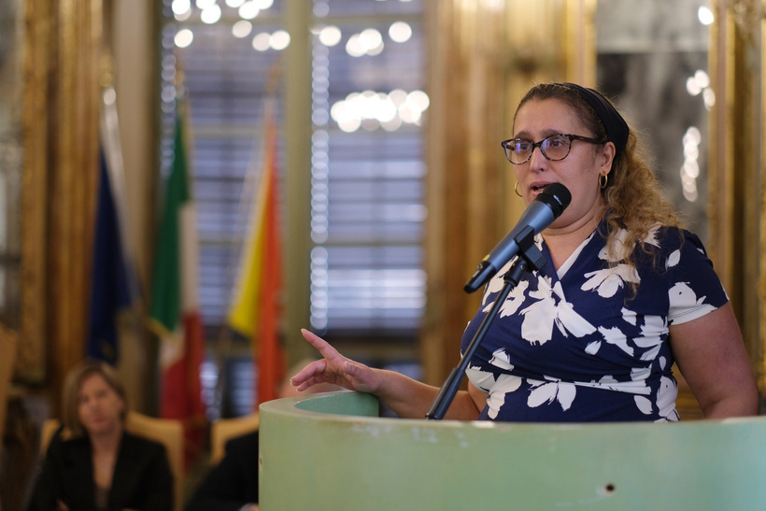

Pierfrancesco Maran
Deputy Mayor for Housing and Neighbourhoods, City of Milan
Paola Zerilli
Scientific Coordinator SUPER-i and SUPERSHINE projects, Associate Professor, Economics Department, University of York, UK
Sven Buch
Development manager, Himmerland Boligforening; External censor, Aalborg University, Denmark
What needs to be changed?

Slide 29
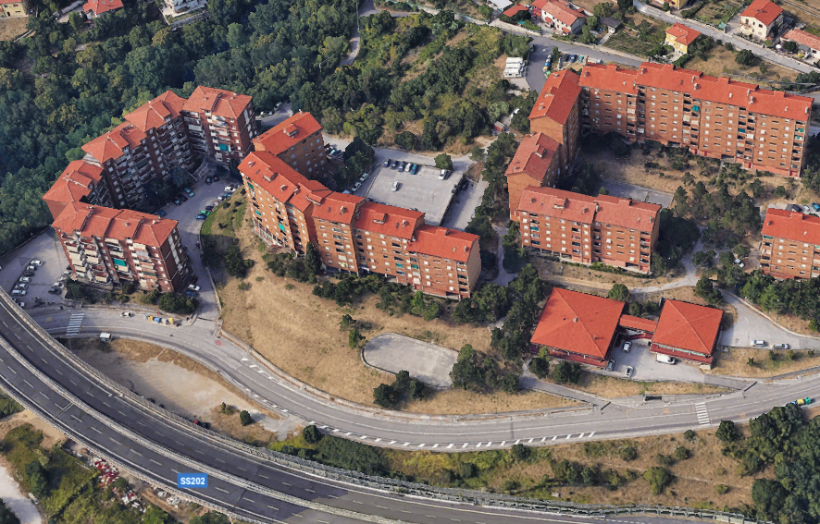
SUPER-i :Pilot Italy comprises two social housing developments
Montasio built in 1976, will be extensively renovated:
It comprises of 20 towers joined into 3 complexes, holding a total of 251 units.
Tower exteriors are made of reinforced concrete, internal walls and roofs are made of concrete and brick.
Hot water for space heating is generated by 3 large gas boilers in the basement in one of the complexes.
Domestic hot water is produced by boilers in the individual apartments.
The current heating infrastructure is to be replaced with high performance condensing gas boilers, and heat exchangers that reclaim waste heat will be installed.
Additional insulation will be added that will reduce the U-values of external walls, and walls between heated and unheated parts of the building to below 0.45W/m²K.
The windows will also be replaced, reducing their U-value to below 1.3.W/m²K.

Slide 30
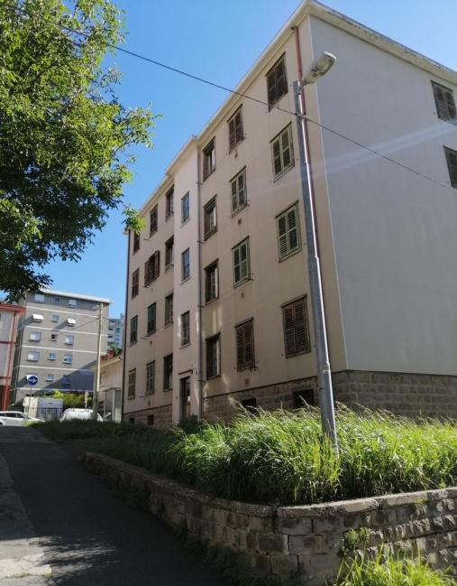
SUPER-i :Pilot Italy comprises two social housing developments
Boito built in 1951 will be entirely rebuilt.
Boito is complex of 8 buildings, each holding 16 apartments (31 to 36 m²), making a total of 128 units.
Boito did not include heating or electrical systems at the time of its construction, though some units have retrofitted gas heaters.
The renovations will entirely remake the buildings to include larger, more energy efficient buildings that meet current standards, and will restore nearly green spaces.

Slide 31
Public Private Partnership (PPP):Direct Credit Line
Involved parties: Social Housing, and Funding institution.
Source of funding: The social housing is responsible for covering the investment costs using financial institutions or government loans.
Payoff structure social housing:
  100% of energy savings
  the social housing company gets the increased value of the building after the energy efficiency intervention.
  Additionally, social housing is responsible for covering the maintenance and operating costs of running the energy efficiency technologies.
In this case, most of the investment risk is taken by the social housing.

Slide 32
Public Private Partnership (PPP): Guaranteed savings
Involved parties: Social Housing, ESCO, and Funding institution.
Source of funding: The social housing is responsible for covering the investment costs using financial institutions or government.
The minimum guaranteed saving for the EE intervention is equal to the interest rate payments on loan (in this case the loan is carried out by the social housing company).
Payoff structure social housing:
  if the energy savings are higher than the minimum guaranteed savings gets minimum guaranteed savings + 20% (energy savings - minimum guaranteed savings)
  if the energy savings are lower than the minimum guaranteed savings gets minimum guaranteed savings
  Additionally, the social housing company gets the increased value of the building after the energy efficiency intervention.

Slide 33
Public Private Partnership (PPP): Guaranteed savings
Payoff structure ESCO:
If the energy savings are higher than the minimum guaranteed savings gets 80% (energy savings - minimum guaranteed savings)
If the energy savings are lower than the minimum guaranteed savings gets (energy savings - minimum guaranteed savings)
Additionally, the ESCO is responsible for covering the maintenance and operating costs of running the energy efficiency technologies.
Most of the investment risk is taken by the ESCO.

Slide 34
Public Private Partnership (PPP) : Shared savings
Involved parties: Social Housing, ESCO, and Funding institution
Source of funding: The ESCO is responsible for covering the investment costs using financial institutions or government.
Payoff structure for social housing
  If the energy savings are higher than the minimum guaranteed savings, gets 35% (energy savings - minimum guaranteed savings)
  If the energy savings are lower than the minimum guaranteed savings, gets 0
  Additionally, the social housing company gets the increased value of the building after the energy efficiency intervention.

Slide 35
Empirical findings for Italy:
Montasio: 25 year Risk Premia 2023-2047

Slide 36

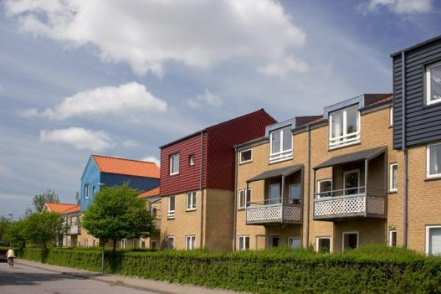

General objectives
Analysing the financial situation of the 3 SUPERSHINE lighthouses (Denmark, Italy, Latvia)
Ensuring adequate and well-targeted funding by supporting innovative financial solutions such as Public Private Partnerships (PPPs) and Green Public Procurement (GPP) and collaborating with innovative local Small and Medium Enterprises (SMEs);
SUPERSHINE will provide tools to support local SMEs in redefining their products process and systems from the point of view of design, production, logistic and business models by adopting technologies to address essential needs of social housing residents
This project has received funding from the European Union’s Horizon Europe research and innovation programme under the grant agreement No 101079963. Topic: HORIZON-CL4-2021-RESILIENCE-02-32: Social and affordable housing district demonstrator (IA)

Slide 37
The SUPERSHINE Italian lighthouse district is composed of 8 buildings, each comprising 4 storeys and 16 dwellings
The total floor space is 4,417 m² with an energy consumption for heating of 131 kWh/m².
ATER Trieste plans to demolish and rebuild these buildings.
The objective is to overcome the functional obsolescence of the district, attributable to the state of deterioration of the buildings, and to overcome the technological inadequacy with an organic series of redevelopment interventions.
A single natural gas condensing boiler will supply heat and hot water for each building.
List of potential innovative solutions and potential benefits for social housing tenants
Each unit will have an individually metered heating system.
Lighting will be provided by low-consumption lamps, and external lighting produces low light-pollution.
External doors and windows of the housing units will be aluminium, thermal break models with thermal imaging glass, and will be equipped with aluminium shutters with wing or book opening.
The building will be thermally insulated using 100mm insulating panels, applied externally to the walls (with a coat type system) and laid on the floor on the mezzanine, in the inter-floors and in the attic with panels of different thickness in relation to the insulation required.
Rooftop solar panels are also to be included
The new dwellings will be assigned to low-income tenants differentiated by composition and age group.
13% are non-EU citizens
21% > 65 years of age
34% are families with minors
Average income indicator is less than 15,000 euros.
Statistics about the average social housing inhabitants in Trieste states that:

Slide 38
16h00-16h45
BEYOND FINANCE: THE LABOUR SHORTAGE IN CONSTRUCTION AND RENOVATION
Académie du Climat
20 June 2023
Affordable Housing Initiative
Finance Summit
www.shape-affordablehousing.eu
Paris, France

Slide 39
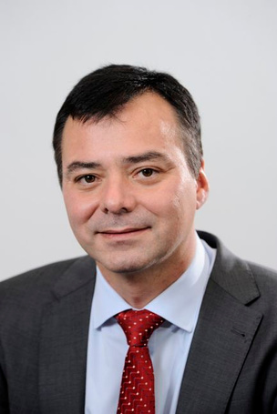
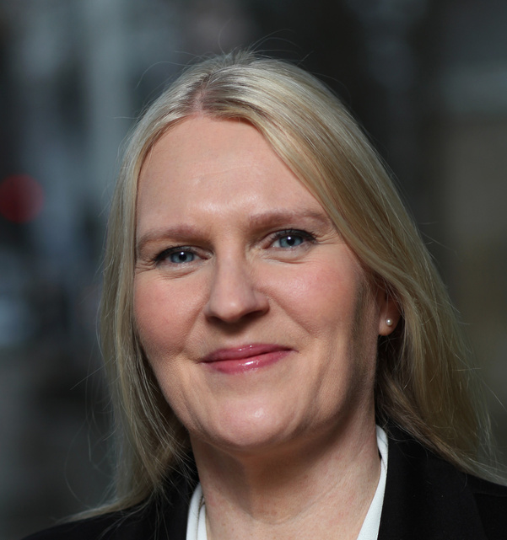
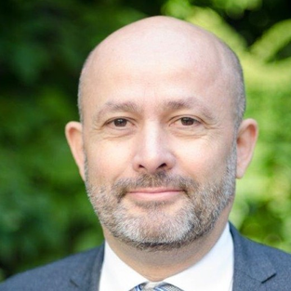
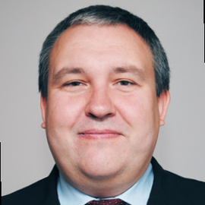
Ozgur Oner
Head of EU Affairs, Federal Association of German Housing and Real Estate Companies
Kristina Hultgren
City of Stockholm, Labour Market Department
Jean-François Gore
Director General of the French Building Federation
Roman Horvath
Policy Officer, Directorate General for Internal Market, Industry, Entrepreneurship and SMEs, Pact for Skills
Beyond FInance: the labour shortage in construction and renovation

Slide 40



ESF-project Sverige Bygger Nytt
A value chain
1 Invitation
Selection
Information meeting
2 The Toolbox
Test
3 Education/
validation
Pre vocational training
Internship
Dialogue
Registratiion
Soft skills
Industry information
Validation
4 Job match
Employment
Vocational training
Guidance
VR (Virtual reality)
Language support

Slide 41
16h45-17h00
CLOSING SPEECHES
Académie du Climat
20 June 2023
Affordable Housing Initiative
Finance Summit
www.shape-affordablehousing.eu
Paris, France

Slide 42

Bent Madsen
President of Housing Europe
Ian Brossat
Vice-Mayor on Housing, city of Paris
Closing Speeches

